Slide 1
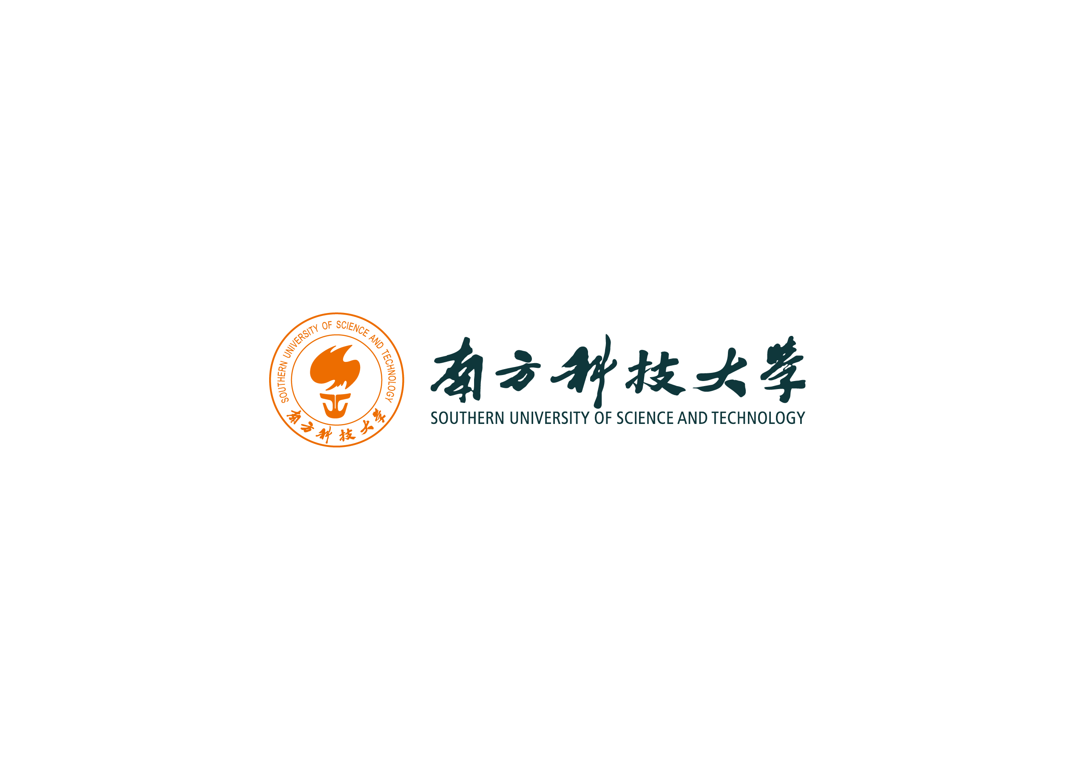

TMK1-mediated auxin signalling regulates
differential growth of the apical hook
Presenter: Guangshuo Guo
2023.5.14

Slide 2
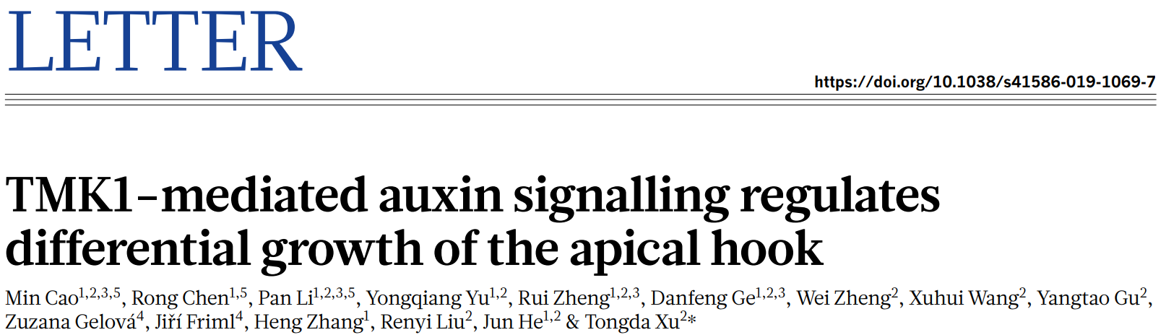
Notes:
是Nature期刊的一种论文类型，发表一些篇幅短小但具有重要意义的文章，通常放在首页或重要位置

Slide 3

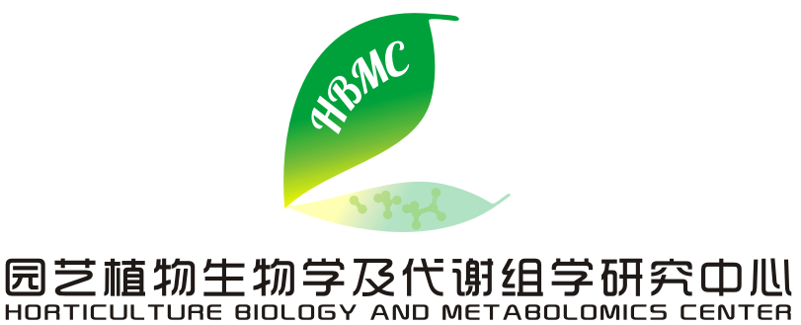
About the author
Co-first author: Min Cao, Rong Chen, Pan Li
Co-corresponding author: Tongda Xu and Jun He
Related institutions:
1. Shanghai Center for Plant Stress Biology, Chinese Academy of Sciences.
2. FAFU-UCR Joint Center for Horticultural Biology & Metabolomics.
Notes:
FAFU-UCR园艺生物学与代谢组学联合中心是福建农林大学（Fujian Agriculture and Forestry University，简称FAFU）与加州大学河边分校（University of California, Riverside，简称UCR）合作建立的一个科研中心。

Slide 4
Part I.
Background Introduction

Slide 5
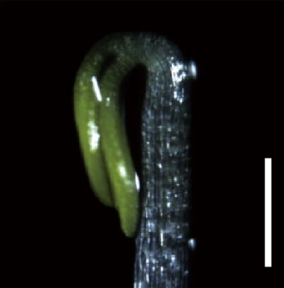
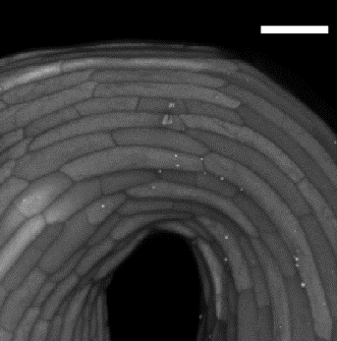
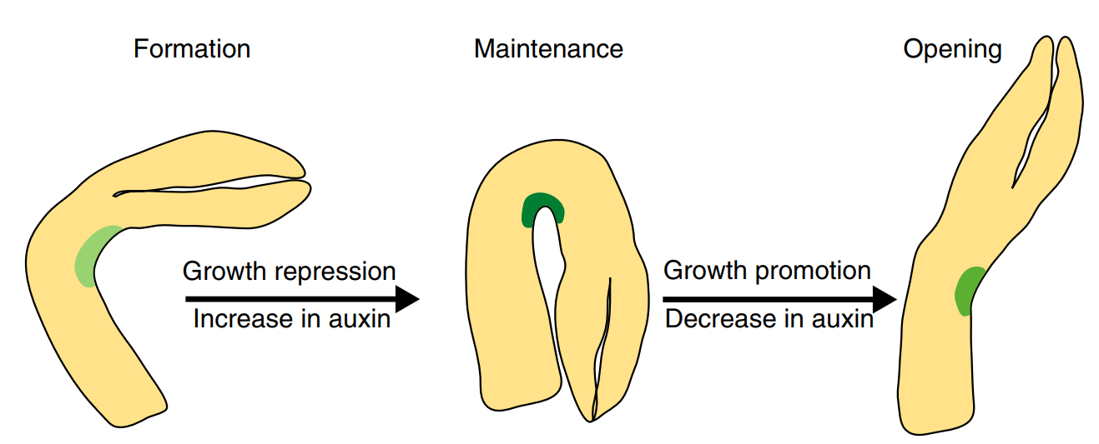
What is apical hook
Convex (outer) side
Hook-like structure
Three stages of apical hook development
Concave (inner) side
(Cao et al., nature, 2019)
As a structure: Protect delicate apical meristem
As a research model: Easily observed (angle)
(Béziat & Kleine-Vehn, Current Biology, 2018)

Slide 6
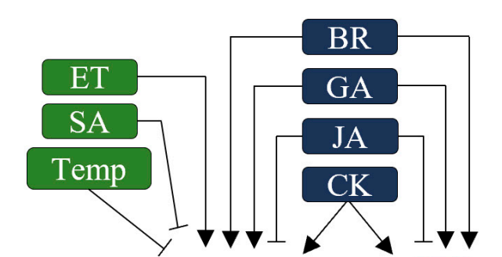
The importance of auxin to apical hook development
Auxin is important for differential growth (apical hook development)
Apical hook is an ideal phenotype to study auxin signalling pathway
Polar auxin distribution
Canonical Auxin signaling pathway:
Apical hook development
Auxin
TIR1
IAA/AUX
ARF
Auxin response gene (Apical hook development)
(Adapted from Aizezi et al., Life, 2022)
(Cao et al., nature, 2019)
Notes:
在顶端弯钩的发育过程中，生长素起到了至关重要的作用

Slide 7
Polar auxin distribution
Scientific problem: To further uncover the mechanism under auxin regulating apical hook development
?
Apical hook development
Highlights of this research:
Revealing another auxin signaling pathway different from the canonical one.

Slide 8
Part II.
Experiments and Results

Slide 9
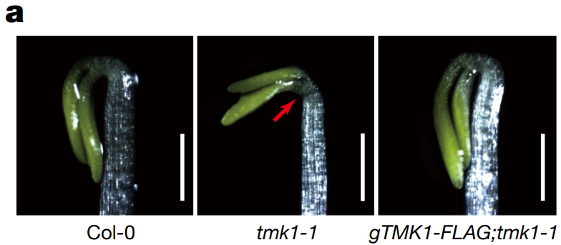
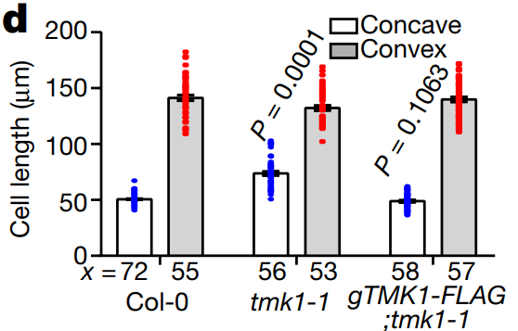
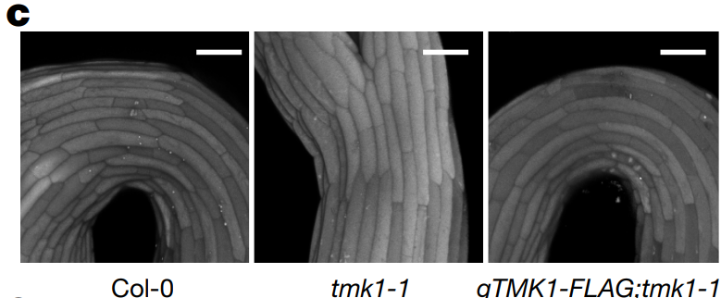
TMK1 functions in down-stream of auxin-signal transduction
Exp.1: Screening apical hook defective mutants related to auxin signalling
Result: tmk1 mutant shows inhibition of hook development
TMK1
Apical hook development
Notes:
首先，用生长素相关的突变体进行顶端弯钩的表型筛选

Slide 10
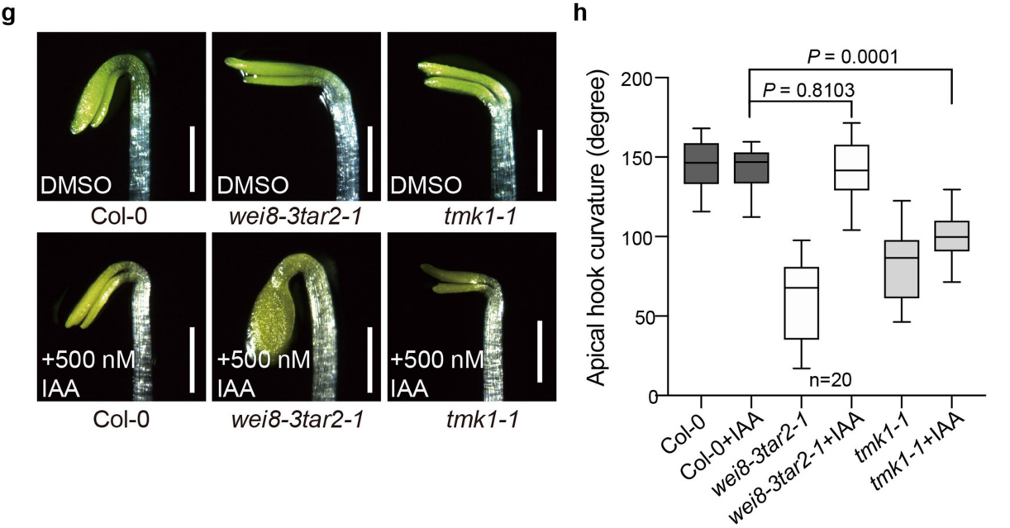
TMK1 functions in down-stream of auxin-signal transduction
Exp.2: tmk-1 with treatment of auxin
Result: No use to recover hook
Auxin
TMK1
Apical hook development
*wei8 tar2: decreased auxin biosynthesis
Notes:
之后，向tmk1-1突变体施加生长素，来判断TMK1和生长素的上下游关系

Slide 11
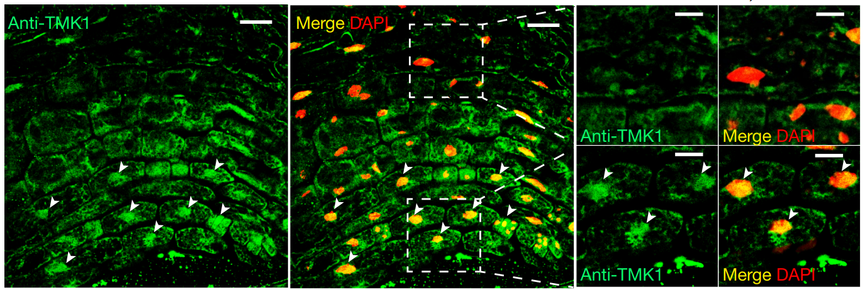
TMK1 is specifically cleaved at the inner side of the hook mediated by auxin
Exp.1: Immunolocalization of TMK1
Result: TMK1 distributes at the inner side in both cytosol and nucleus
Auxin
?
TMK1
Apical hook development
Green: TMK1 distribution
Red: Nucleus localization
Notes:
确定了TMK1和生长素的上下游关系后，文章又着手去研究生长素是如何作用于TMK1的
TMK1主要分布在顶端弯钩内侧，且细胞核与细胞质中均有分布

Slide 12
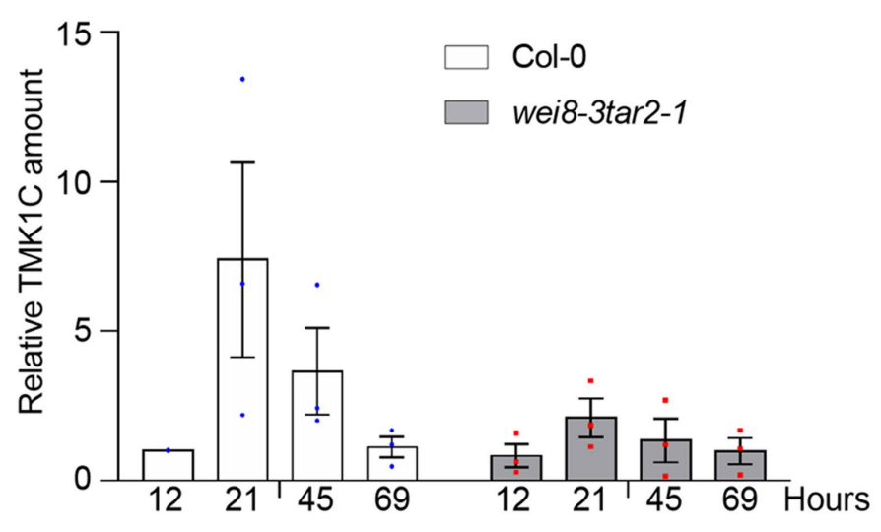
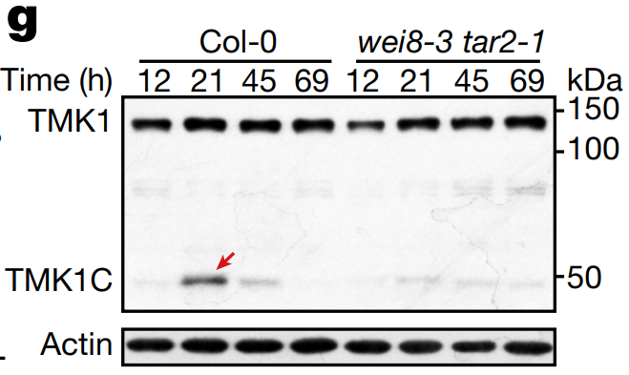
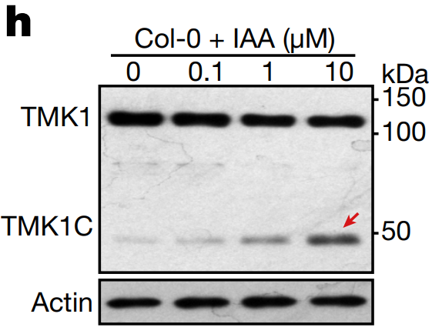
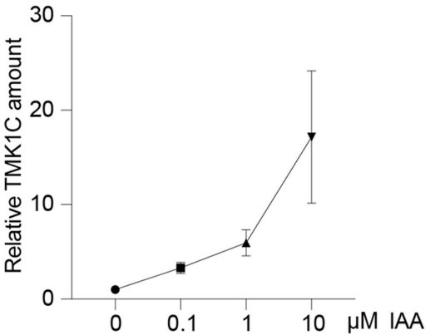
TMK1 is specifically cleaved at the inner side of the hook mediated by auxin
Exp.2: TMK1 C-terminus (TMK1C) content detection
Result: Auxin accumulation at the inner side leads to cleavage of TMK1C
wei8 tar2: Decreased auxin biosynthesis
IAA: a type of auxin
Notes:
在确定了TMK1的位置后，文章又去鉴定了顶端弯钩中TMK1 C-terminus的含量
至于为什么作者会想到western blot检测TMK1C的含量，文章中并未提及
第一个图直接用western blot，检测了不同阶段的Col-0和wei8tar2的TMK1的含量（21h处，wei8tar2的TMK1含量很高，但是TMK1C的含量很低）
第二个图用IAA浓度梯度处理，发现TMK1的含量没有明显变化，但是TMK1C的含量随着生长素浓度的升高而不断增加

Slide 13
How does TMK1 cleavage contribute to apical hook development?
Auxin
Canonical auxin signaling pathway:
TMK1C (TMK1 cleavage)
Auxin
TIR1
IAA/AUX
?
?
TMK1C
Apical hook development
Notes:
在前面的研究中，我们阐明了生长素作用在TMK1的机制，那就是将TMK1的C-terminus切下来
继续研究下去，我们就要看TMK1C是如何起作用从而影响顶端弯钩的发育的

Slide 14
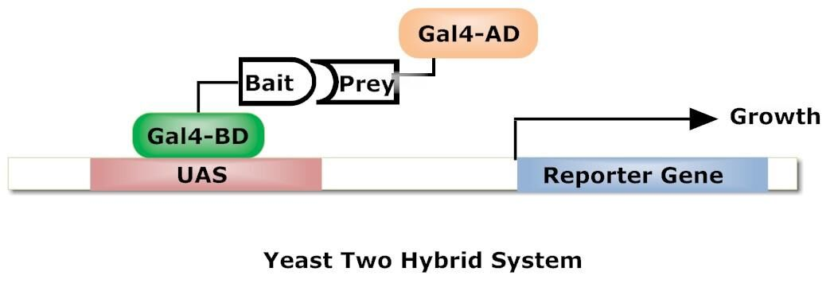
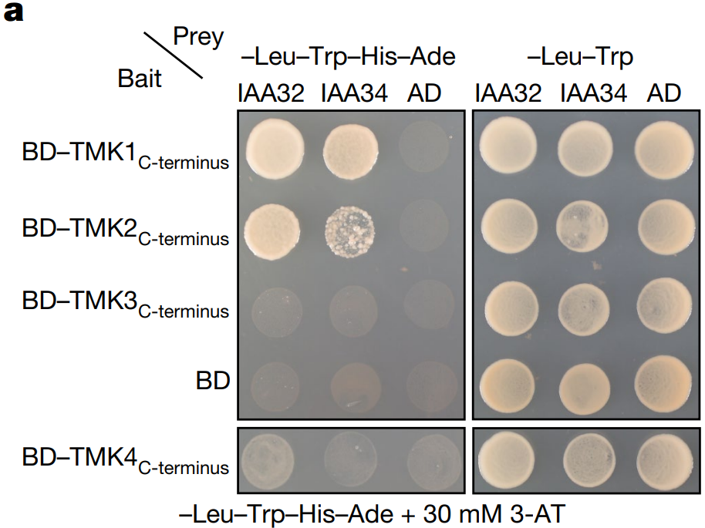
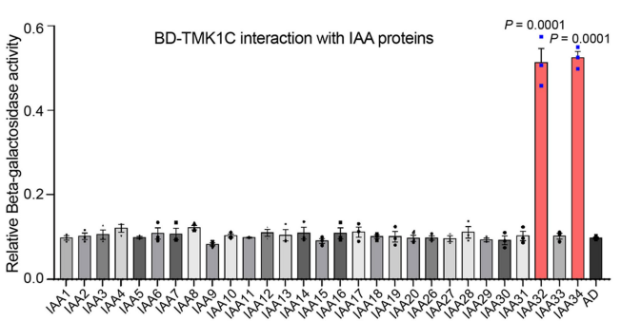
TMK1 interacts with IAA32/34 in non-canonical auxin signalling pathway
Exp.1: Yeast-2-hybrid of IAA/AUX family and TMK
Result: TMK1 interacts with IAA32/34
Auxin
TIR1
IAA/AUX
Notes:
首先作者使用酵母双杂实验进行蛋白互作验证，
互作对象找的是一些潜在的，可能与TMK1C互作的经典auxin信号通路上的因子 - 找了29个IAA/AUX proteins
简要介绍酵母双杂的原理

Slide 15
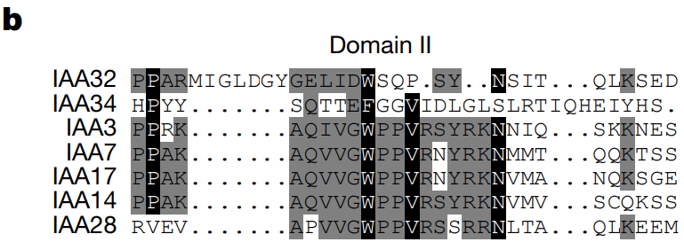
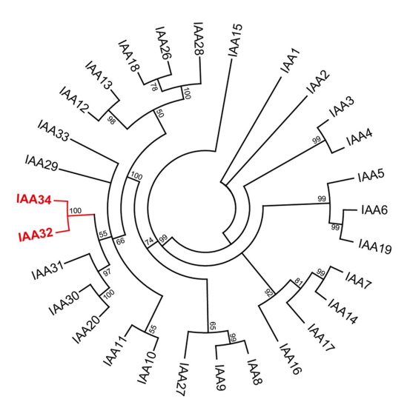
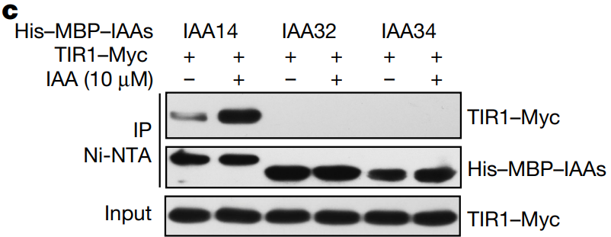
TMK1 interacts with IAA32/34 in non-canonical auxin signalling pathway
Exp.2: Phylogenetic tree analysis & pull-down assay
Result: IAA32/34 are non-canonical IAA proteins that lack domain II
* Domain II: Essential for interacting with TIR1 receptor
Auxin
IAA/AUX
TIR1
Canonical Auxin signalling pathway
Notes:
IAA32/34并非常见的IAA蛋白，所以文章就去详细探究了IAA32/34和IAA蛋白家族中其他成员的不同
进化树分析和pull down实验
Pull down实验证明了IAA32/34与TIR不会发生相互作用

Slide 16
TMK1 interacts with IAA32/34 in non-canonical auxin signalling pathway
TMK1C
?
IAA32/34
Auxin
TIR1
×
Stabilize or destabilize?
Notes:
所以我们弄清楚了，TMK1C能够与IAA32/34相互作用，并且IAA32/34并不在传统的生长素信号通路上
但是我们只知道了TMK1C能与IAA相互作用，但是还不清楚相互作用的具体机制

Slide 17
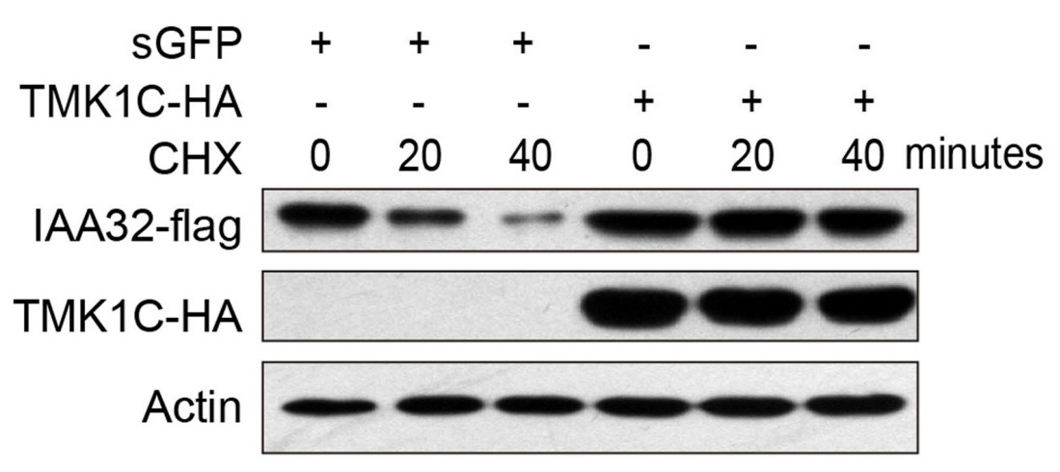
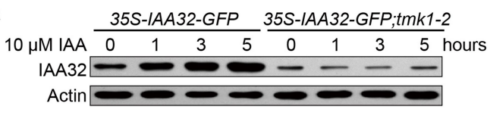
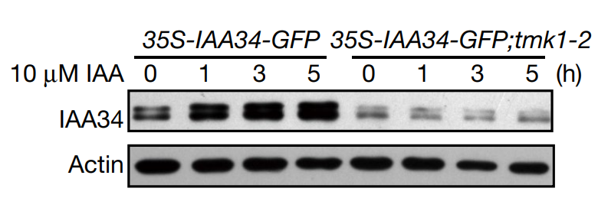
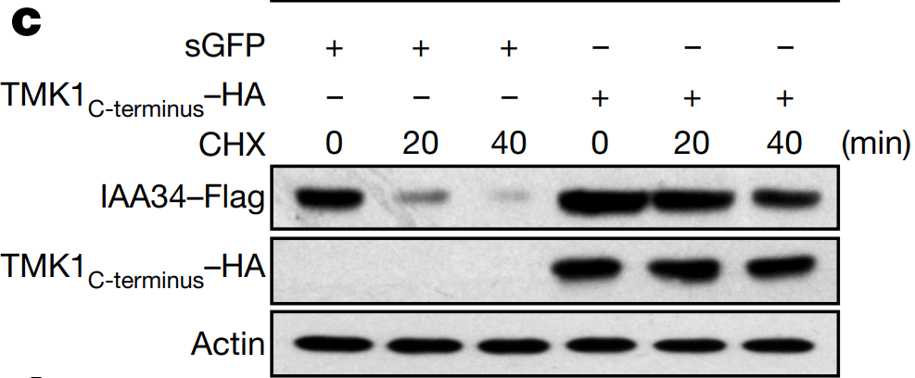
TMK1C stabilizes IAA32/34 via kinase domain
TMK1C stabilizes IAA32/34
Notes:
通过设计了一系列的western blot，文章证明了TMK1C是可以稳定IAA32/34，减缓他们的降解
左图是看在tmk1中，IAA32/34的降解速度会不会更快（也就是在同一时间，tmk1的本底含量更低）
右图是看额外转入了TMK1C，IAA32/34的降解速度会不会变慢
CHX是一种化合物，促进IAA34的降解

Slide 18
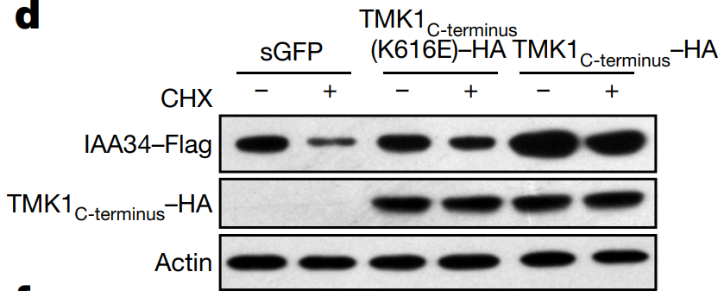
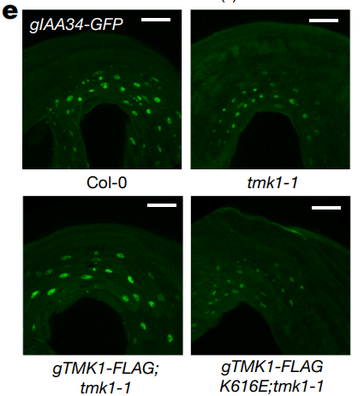
TMK1C stabilizes IAA32/34 via kinase domain
Kinase domain is essential for IAA32/34 stabilization
*K616E: TMK1C-terminal kinase domain is inactivated
Notes:
之后文章又细化了这个机制的研究，用三个转基因株系的western blot证明了TMK1C通过激酶活性稳定了IAA32/34
E图中，将IAA34和GFP融合在一起，荧光代表IAA34的含量。在tmk1中分别回补了TMK1和TMK1 K616E

Slide 19
How does IAA32/34 affect apical hook development?
Stabilize
?
Auxin
TMK1C
IAA32/34
Apical hook development
TIR1
×
Canonical Auxin signalling pathway
Notes:
所以，TMK1C通过激酶区域稳定IAA32/34，从而实现了对顶端弯钩发育的调控，接下来的任务就是探究IAA32/34对顶端弯钩发育的作用机制

Slide 20
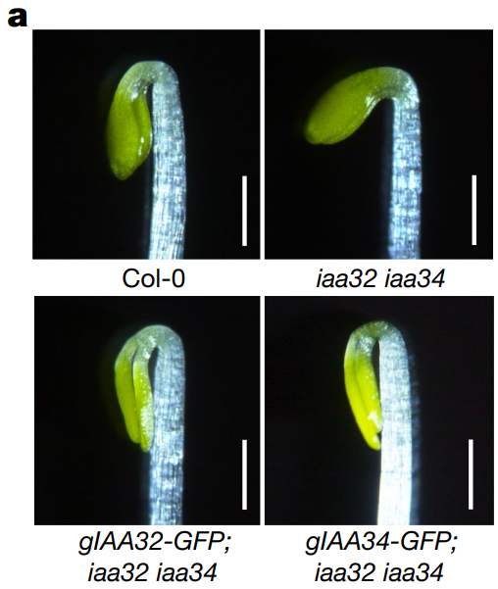
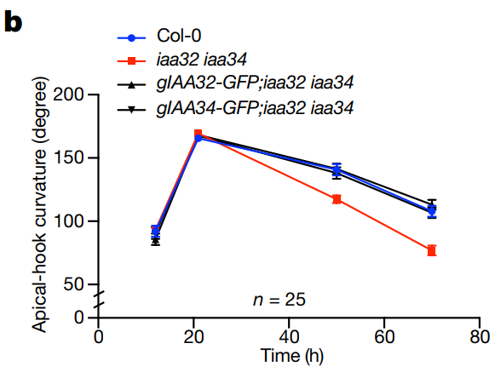
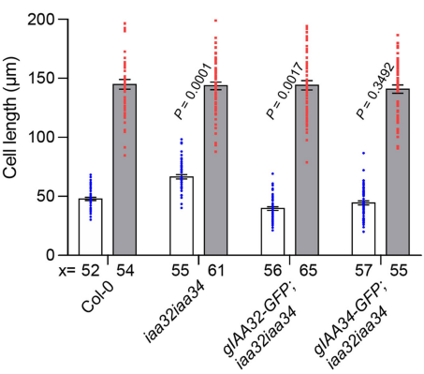
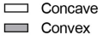
IAA32/34 repressors regulate gene transcription by regulating ARF activity at concave side
iaa32 iaa34 inhibit apical hook by promoting concave (inner) side cell length
Notes:
首先作者构建了iaa32 34的双突，测试了顶端弯钩表型，发现和tmk1相似，都是内侧的细胞长度发生了变化

Slide 21
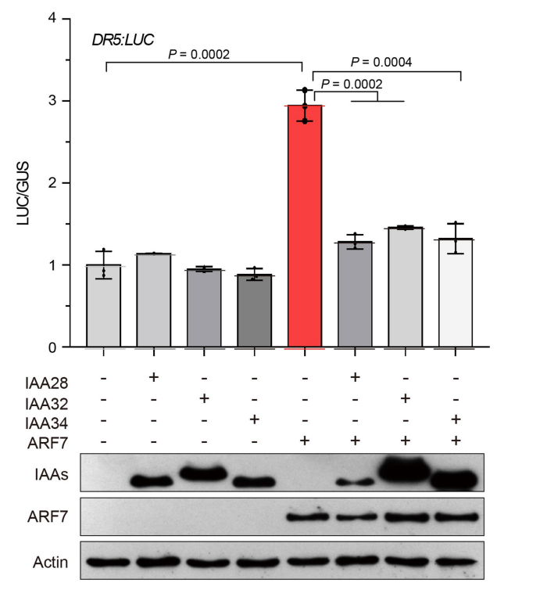
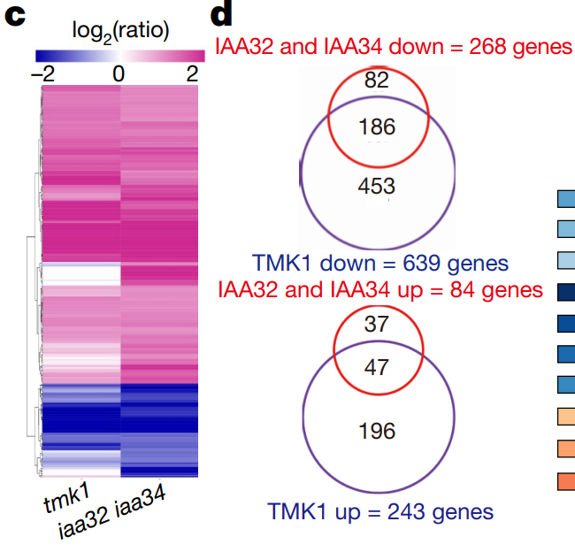
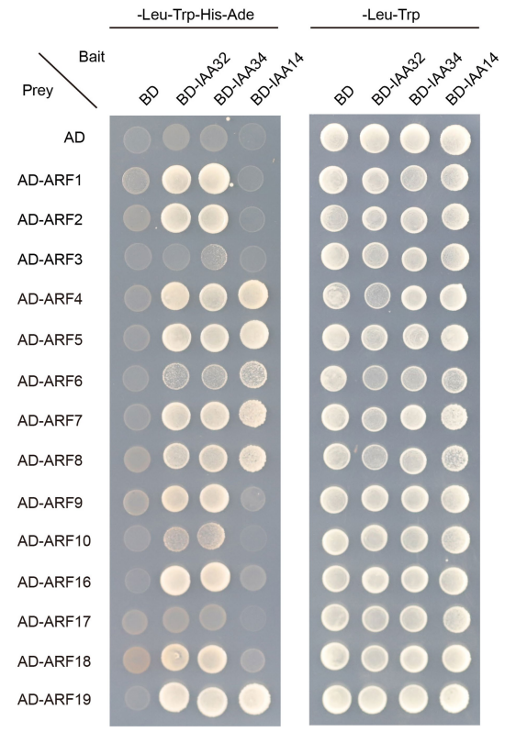
IAA32/34 repressors regulate gene transcription by regulating ARF activity at concave side
IAA32/34 interact with ARF at concave side
IAA32/34
ARF
Apical hook development
Notes:
现在的难点就是，要找IAA32/34下游的互作蛋白，如何下手？
一个很自然的想法是去验证经典生长素通路IAA/AUX下游的转录因子ARF
利用酵母双杂验证了IAA32/34与ARF互作
然后又利用LUC活性实验，间接验证了IAA32/34抑制了ARF活性
做了一个RNA-seq丰富实验证据，iaa32/34和tmk1突变之后下调转录的共同基因里，有很大一部分都是ARF相关蛋白

Slide 22
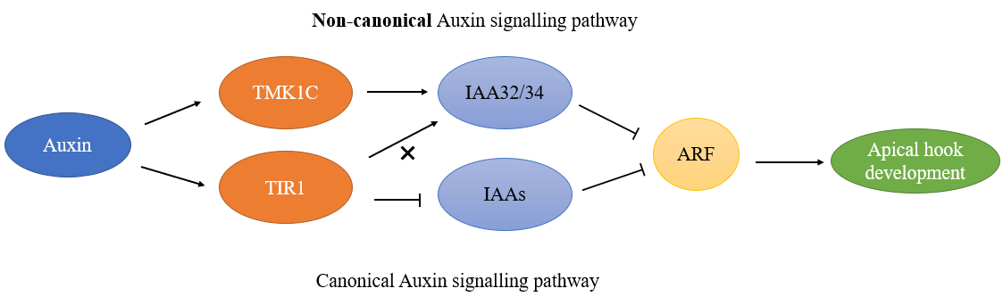
Finally, we can tell the whole story…
Notes:
到此为止，整个文章的故事就到达尾声了

Slide 23
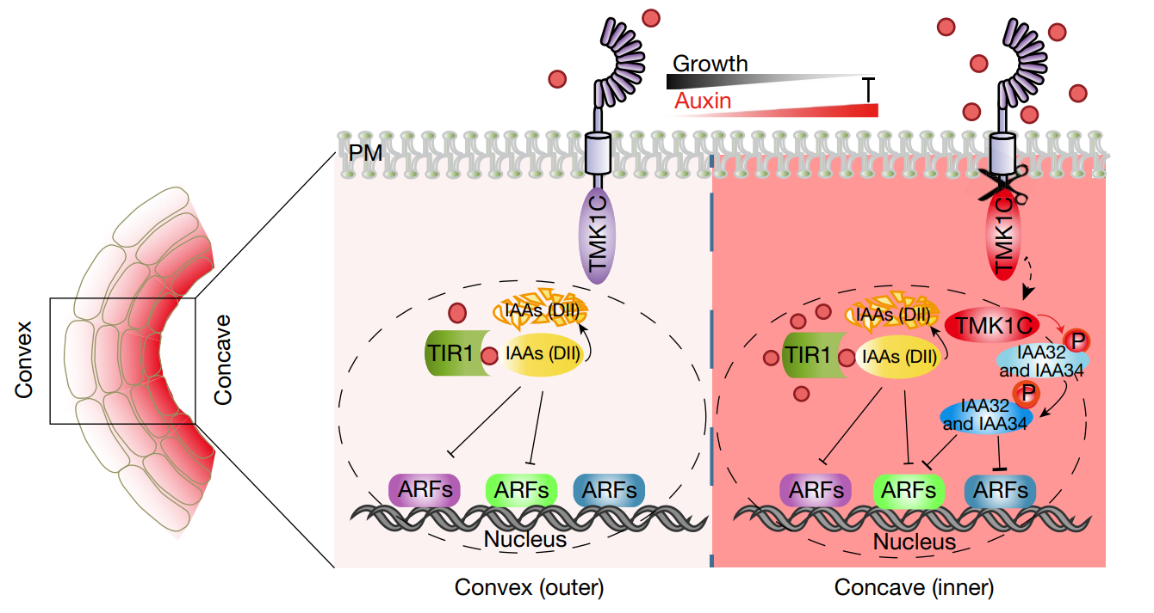
Finally, we can tell the whole story…
Notes:
为什么只在concave side有这个机制？因为tmk1和iaa32/34突变体都只是促进了内侧细胞的伸长，并没有影响外部细胞长度
也就是说，TMK1C和IAA32/34的pathway只在高浓度生长素诱导下发生，也就是只在concave side发生

Slide 24
Part III.
Comments on this article

Slide 25
Huge significance of this paper
Uncover another auxin signalling pathway that contributes to high concentration of auxin inhibiting growth

Slide 26
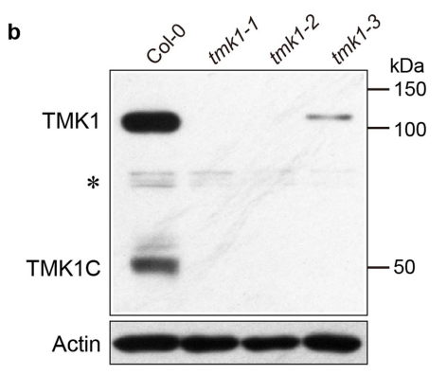
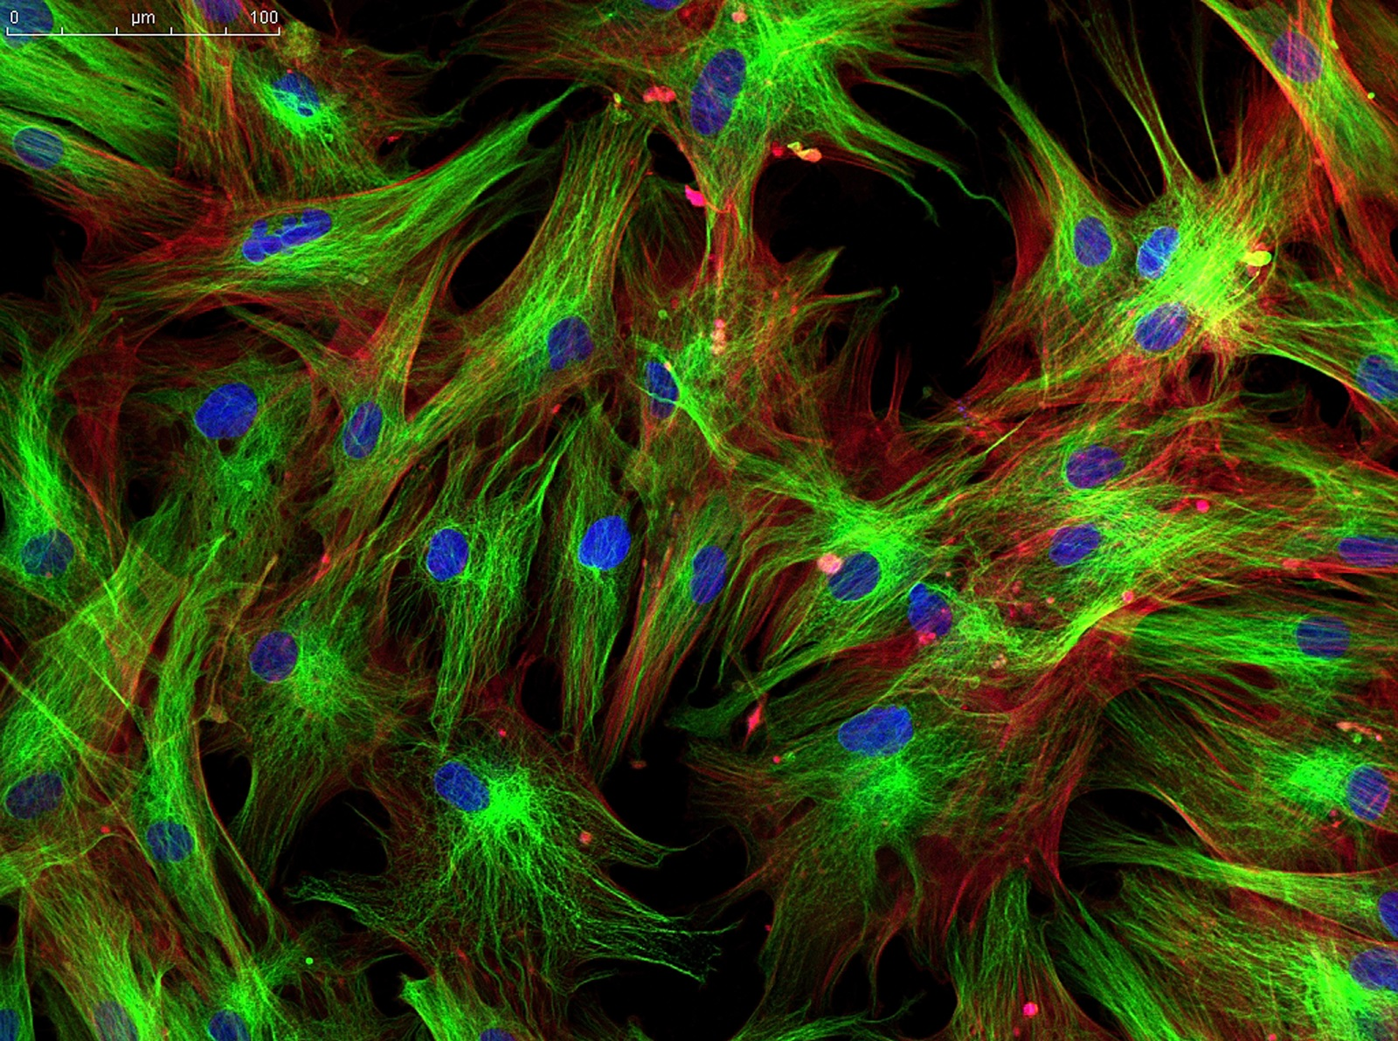
A confusing place
“We analyzed the in vivo distribution pattern of TMK1 protein by immunostaining, using anti-TMK1 C terminus antibody (Extended Data Fig. 2b).”
Ext Fig 2b. Western blot of the proteins extracted from the apical hook of Col-0 and different tmk1 alleles by TMK1C-terminus antibody

Slide 27
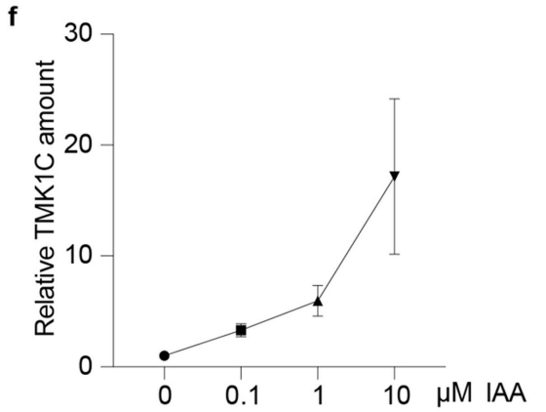
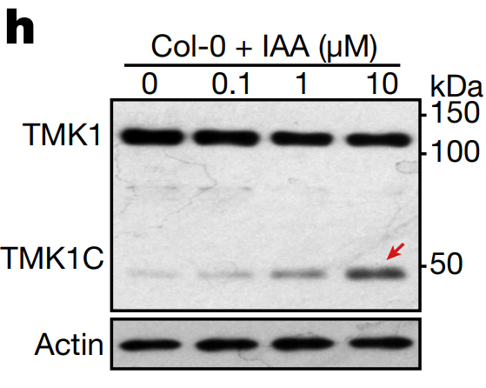
A small mistake in this nature article
Fig. 1h
Notes:
第一个图直接用western blot，检测了不同阶段的Col-0和wei8tar2的TMK1的含量（21h处，wei8tar2的TMK1含量很高，但是TMK1C的含量很低）
第二个图先用immunoprecipitation把GFP蛋白拉下来，再用western blot去检测

Slide 28
Reference:
Aizezi, Y., Xie, Y., Guo, H., & Jiang, K. (2022). New Wine in an Old Bottle: Utilizing Chemical Genetics to Dissect Apical Hook Development. Life (Basel, Switzerland), 12(8), 1285. https://doi.org/10.3390/life12081285
Béziat, C., & Kleine-Vehn, J. (2018). The road to auxin-dependent growth repression and promotion in apical hooks. Current Biology, 28(8), R519-R525.
Cao, M., Chen, R., Li, P., Yu, Y., Zheng, R., Ge, D., ... & Xu, T. (2019). TMK1-mediated auxin signaling regulates differential growth of the apical hook. Nature, 568(7751), 240-243.
Notes:
第一个图直接用western blot，检测了不同阶段的Col-0和wei8tar2的TMK1的含量（21h处，wei8tar2的TMK1含量很高，但是TMK1C的含量很低）
第二个图先用immunoprecipitation把GFP蛋白拉下来，再用western blot去检测

Slide 29
Thank you！
Notes:
第一个图直接用western blot，检测了不同阶段的Col-0和wei8tar2的TMK1的含量（21h处，wei8tar2的TMK1含量很高，但是TMK1C的含量很低）
第二个图先用immunoprecipitation把GFP蛋白拉下来，再用western blot去检测

Slide 30
Non-canonical Auxin signalling pathway
TMK1C
IAA32/34
Auxin
ARF
×
Apical hook development
TIR1
IAAs
Canonical Auxin signalling pathway

